Slide 1



Retail Sales Data Analysis
This project aims to analyze sales data for a major retail chain, uncovering insights to drive strategic decision-making and improve business performance.
by Smruti Ranjan Biswal
SB

Slide 2

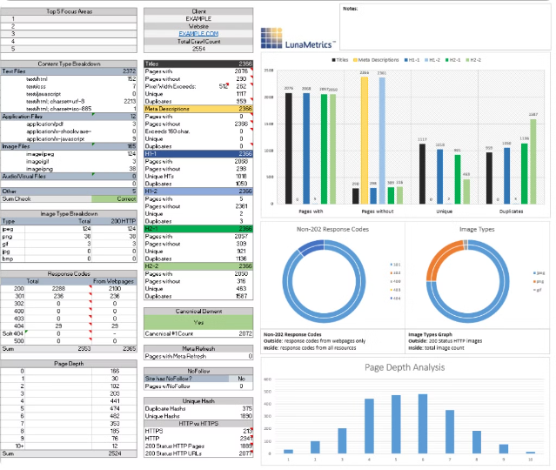
Data Sources and Extraction
1
Point-of-Sale (POS) Data
Comprehensive sales transaction records from all retail locations.
2
Inventory Management System
Data on product stock levels, shipments, and inventory turnover.
3
Customer Profiles
Demographic and purchasing behavior data for loyal customers.

Slide 3
Data Cleaning and Transformation
Data Validation
Feature Engineering
Aggregation
Identify and resolve missing values, outliers, and inconsistencies.
Create new variables to provide deeper insights, such as average order value and customer lifetime value.
Group data by dimensions like time, location, and product category to enable robust analysis.

Slide 4

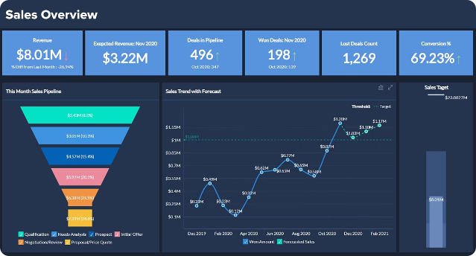
Exploratory Data Analysis
1
Sales Trends
Analyze monthly and seasonal sales patterns to identify growth opportunities.
2
Product Performance
Evaluate top-selling items, profit margins, and inventory turnover by category.
3
Customer Segmentation
Group customers based on purchase behavior and demographic attributes.

Slide 5


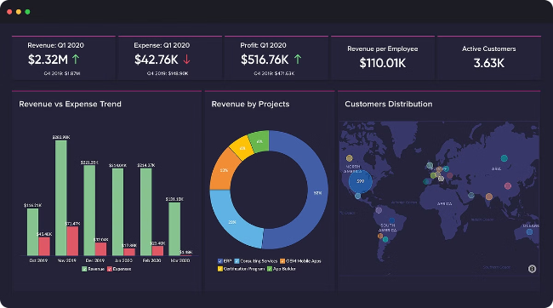


Reporting and Visualization
Interactive Dashboards
Deliver real-time insights through visual reports and KPIs.
Automated Reporting
Generate scheduled reports for stakeholders and decision-makers.
Presentation-Ready Visualizations
Develop compelling, data-driven presentations to communicate findings.

Slide 6

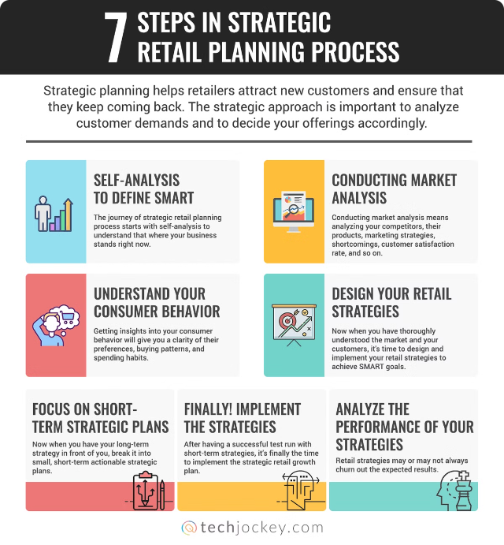




Insights and Recommendations
High-Potential Products
Identify best-selling items with room for further growth.
Optimize Pricing and Promotions
Leverage data-driven strategies to maximize profit margins.
Target Valuable Customers
Focus marketing efforts on the most loyal and profitable segments.

Slide 7

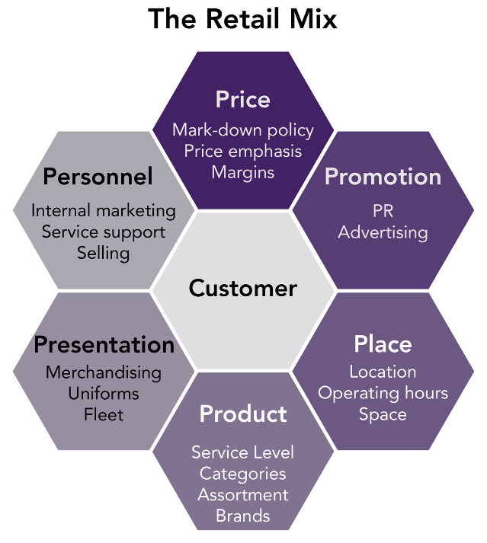
Conclusion and Next Steps
Continuous Improvement
Establish an ongoing data analytics program to drive business growth.
Expand Analysis Scope
Integrate additional data sources to uncover deeper insights.
Implement Recommendations
Collaborate with stakeholders to put insights into action.

